Slide 1
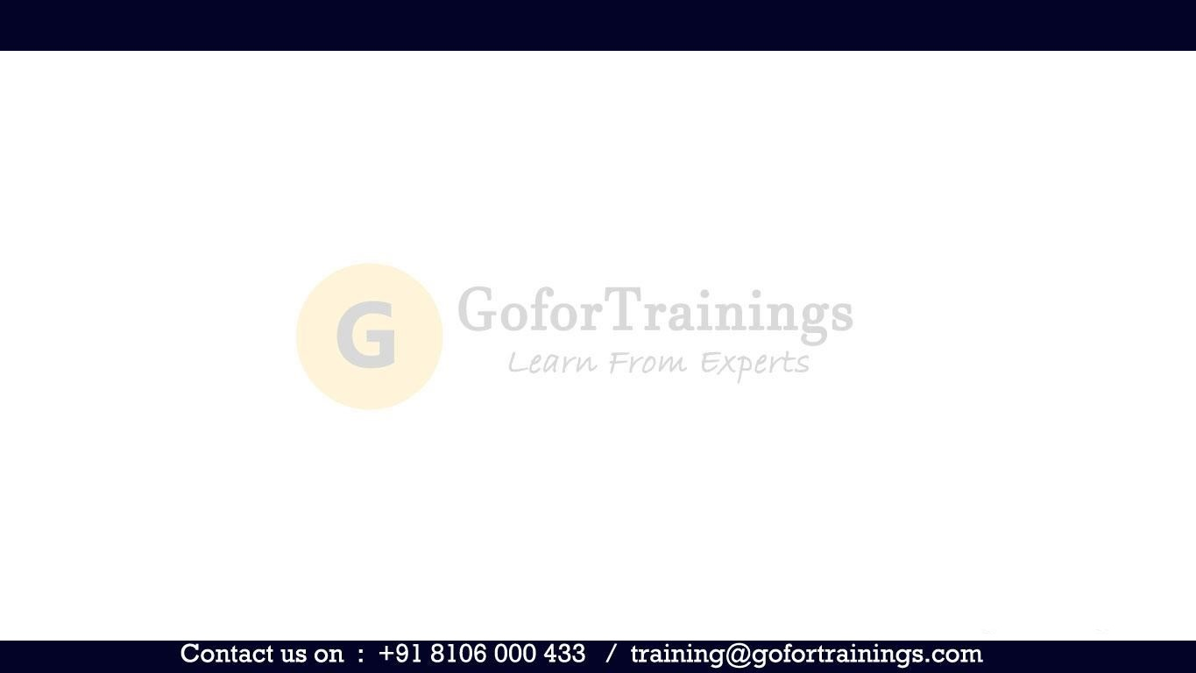
Adobe Target
Training

Slide 2
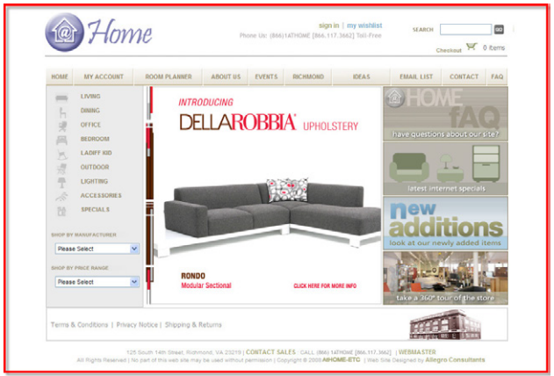
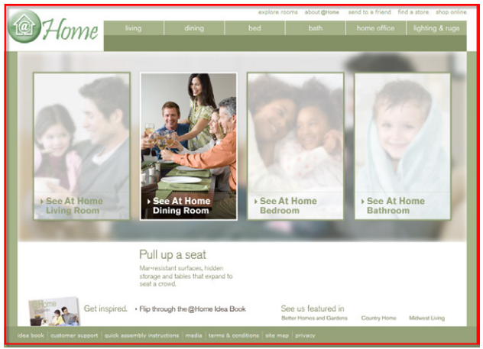
What is Testing?
The entire concept behind testing is to compare a baseline control sample against a variety of test samples, so you can see which is most effective in increasing success, whether you define “success” as improved conversion, increased sales, increased response rates, or some other desired outcome.

Slide 3
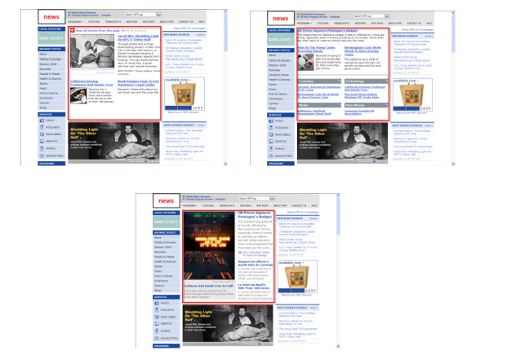
What is Targeting?
The whole point of targeting is to identify how different segments of visitors respond differently to different content, and to leverage that information to create more engaging user experiences. Targeting is different from personalization, or individualization, because with targeting, the objective is to target broad segments most likely to impact your key metrics or bottom line

Slide 4
Adobe Target Premium vs Standard
Target Standard
Target Standard is the front end to Adobe Target that helps you visually create and manage A/B tests and rules-based targeting activities. Target Standard supports custom code insertion both in and out of the Visual Experience Composer (VEC) workflow. Target Standard offers a simplified implementation strategy with your digital properties.
Target Premium
Premium
Target Premium is an advanced Target offering that requires a license to add premium features to Target Standard.
Target Premium includes the following features:
Automated Personalization
Auto-Target
Recommendations

Slide 5
Basic Terms and Concepts
Mboxes
An mbox is the server call made from your web page to Adobe Target
An mbox on a page can be used to:
• display content,
• log visitor behavior, or
• do both; that is, display content and log visitor behavior at the same time.
The name of the global mbox Adobe Target creates and uses is target-global-mbox.
By contrast, Target Premium and Standard do not require mboxes to be coded in the page, but instead give you the option of: • automatically generating a global mbox as needed, behind the scenes • using existing mboxes (whether global or regional) from a previous Adobe Target implementation

Slide 6
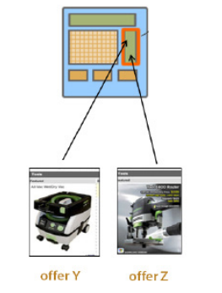
Basic Terms and Concepts
Content
“Content” describes the offer Adobe Target displays on a page.
It may be useful to note “content” refers to both “image offers” (assets) and “code offers” (HTML, Redirect , and Remote offers). In other words, if an “mbox” defines a server call made to Adobe Target, “content” defines what Adobe Target then displays on your page, as a result of that call.

Slide 7
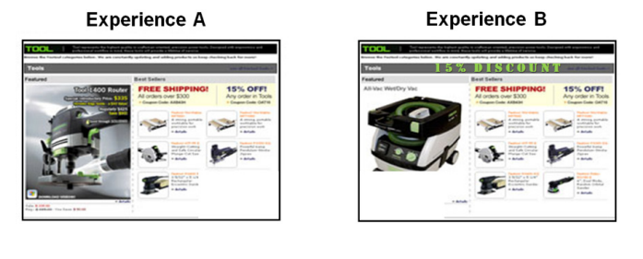
Basic Terms and Concepts
Experiences
An experience is a specific combination of content. Experiences determine which content is displayed in which areas on the page. For example, consider the following two experiences:

Slide 8
Basic Terms and Concepts
Goals
An activity goal occurs when a visitor performs an action on your site that is defined as a success event.
Goals may be defined as “conversion,” "engagement," or "revenue."

Slide 9
Basic Terms and Concepts
Audiences
An audience is a group of people who share a certain characteristic or a set of characteristics. Examples of audiences could include: Visitors from Google, Visitors from Yahoo, Visitors who have purchased in the past, Registered Users, Unregistered Users, Male Visitors, Female Visitors, Visitors over 50 years of age, and so on.
Adobe Target defines audiences at an account level.

Slide 10
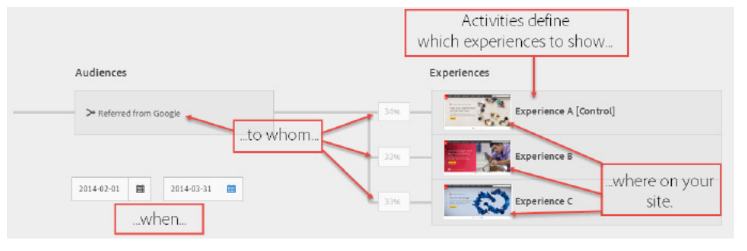
Basic Terms and Concepts
Activity
An activity defines which experiences to show, where on your site, to whom, and when. For example, you could have a “Springtime Ad Activity,” which consists of Experience A, Experience B, and Experience C display on certain locations on your site, and run from February through March. Traffic will be split evenly between the three experiences.

Slide 11
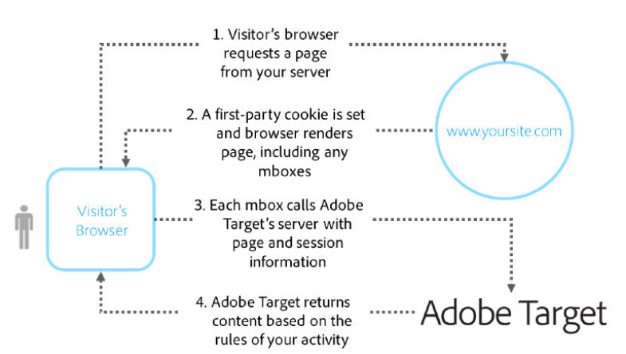
How Target Works?

Slide 12
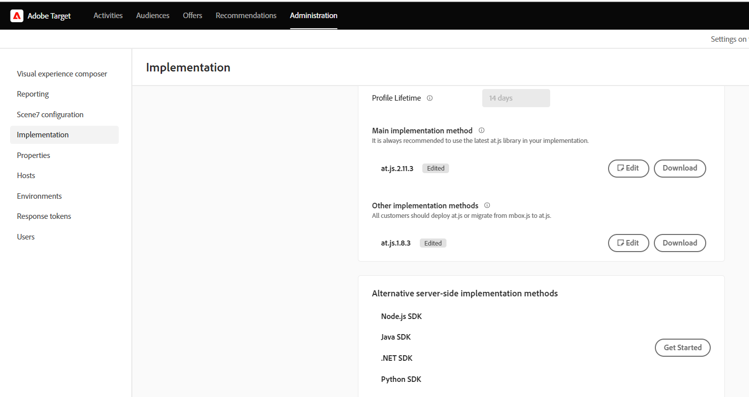
at.js
Adobe Target requires you to install a file called at.js (or mbox.js) onto your web server. This is a JavaScript library that enables communication between your site and the Adobe Target servers.
• at.js is a small file that allows your visitors’ browsers to talk to Adobe Target.
• Target provides you with an at.js file specific to your account.
• Only one at.js is necessary for all of your activities.

Slide 13
Types of Activity
Activity Type | Description
A/B Test | A/B Testing compares two or more versions of your Web site content to see which version best improves your conversions during a pre-specified test period.
Experience Targeting | Experience Targeting (XT) delivers content to a specific audience based on a set of marketer-defined rules and criteria.
Multivariate Test | Multivariate Testing (MVT) compares combinations of offers in elements on a page to determine which combination performs the best for a specific audience, and identifies which element most impacts the activity’s success.
Automated Personalization | Automated Personalization (AP) combines offers or messages, and uses advanced machine learning to match different variations to each visitor based on their individual customer profile
Recommendations | A recommendation determines how a product is suggested to a website user, depending on that user’s activities on the site.

Slide 14
A/b Test
A manual A/B Test activity compares two or more versions of your website content to see which version best improves your conversions during a pre-specified test period.
A manual A/B Test activity (sometimes referred to as an A/B…N test) compares two or more versions of your Web site content to see which version best lifts your conversions, sales, or other metrics you identify. Use an A/B test to compare changes to your page against your default page design to determine which experience produces the best results.

Slide 15
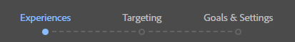
Activity Creation Overview
The activity creation workflow will walk you through the following steps:
1. Experience creation
2. Target
3. Goals & Settings

Slide 16
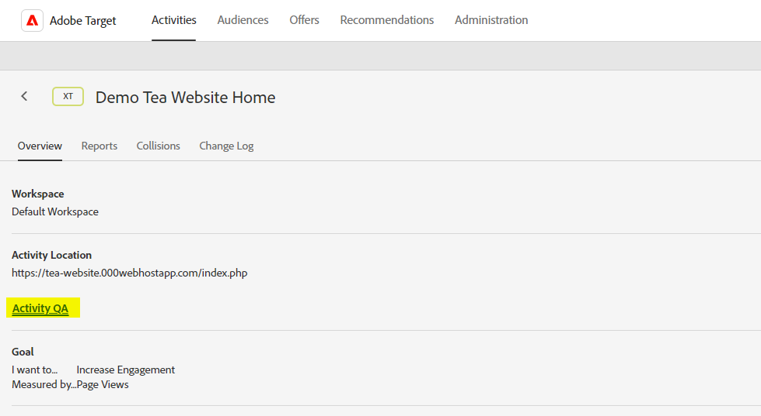
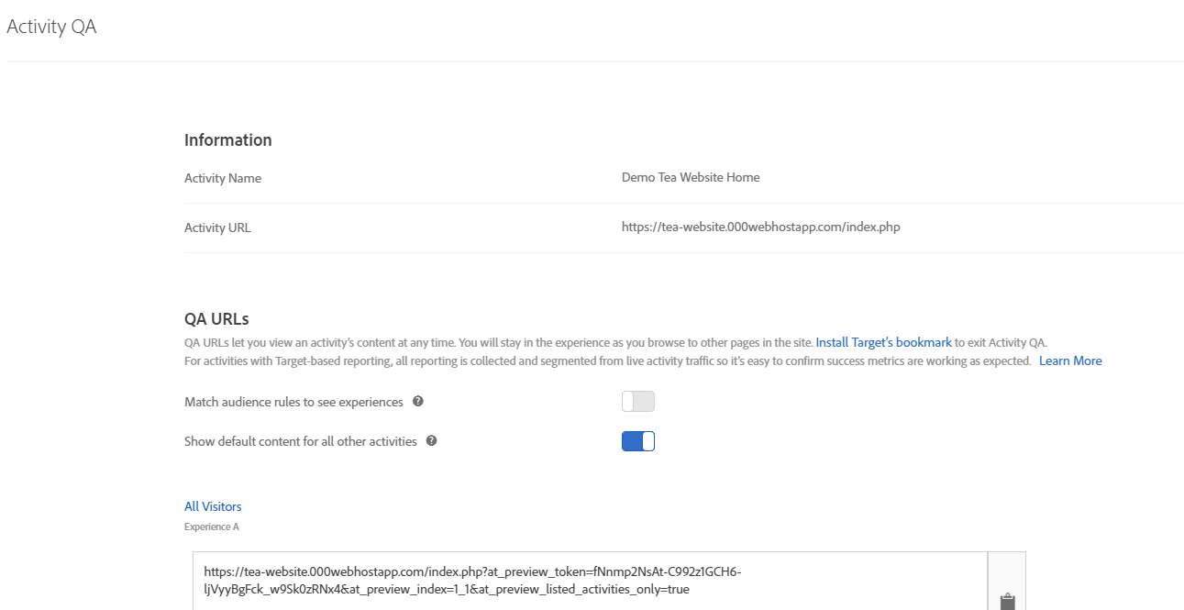
Activity QA
You can access preview links by clicking the “Activity QA” link on the activity’s Overview page.

Slide 17
Activity QA
Benefits of using preview links for QA:
• Allows a user to test the look and feel of the activity, since the content renders precisely as it will in the final published activity.
• Easy to qualify—you do not have to meet the audience targeting criteria
• Great for browser compatibility tests. Launch the links in different browsers to confirm they render as expected.
• Easy to share with team members who do not have or want a Target login. Viewing the preview links does not require access to Target.
Cautions regarding using preview links for QA:
• Must use correct process for copying and distributing links.
• Cannot test reporting or success metrics

Slide 18
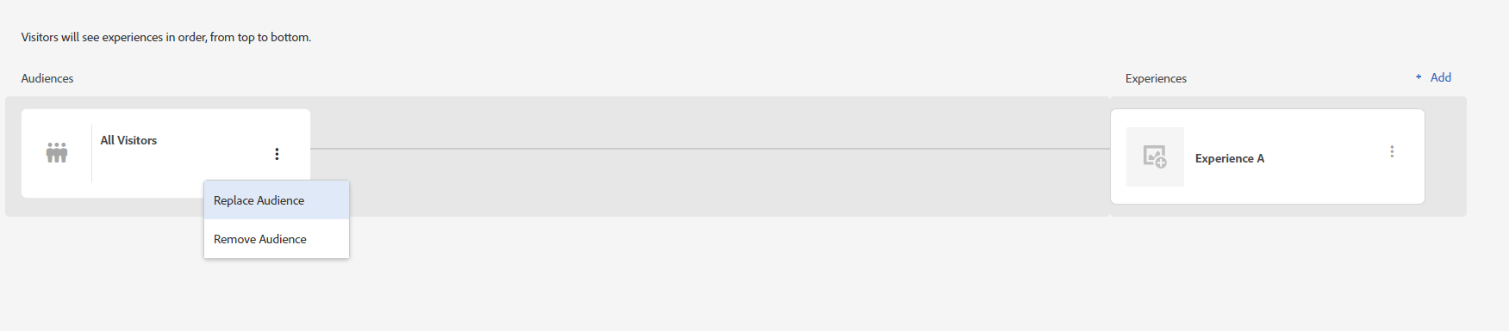
Activity QA
Testing with QA parameters Testing with QA parameters involves deploying a version of the activity that is targeted so only a very narrow group of test visitors are allowed into the activity.

Slide 19
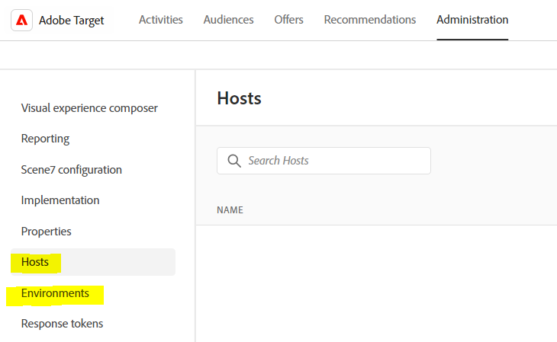
Hosts and Environments
Adobe Target hosts and environments provide a method for leveraging your existing Development, Testing, Staging, or other non-production environments in order to perform QA. This process involves defining those environments within Target, then sending test traffic to only the nonproduction ones

Slide 20
Hosts and Environments
A host is any web server (or web domain) from which you serve content during any stage of your project. For example, you may have hosts named test.mysite.com, dev.mysite.com, and mysite.com.
Hosts are bundled into environments for ease of management. For example, test.mysite.com might belong to the Staging environment, dev.mysite.com might belong to the Development environment, and mysite.com might belong to the Production environment.
When a host is first lazy-loaded, it will appear by default within the Production environment.

Slide 21
Hosts and Environments
How to use environments?
You can configure your Development and Staging environments to reflect active and inactive activities. But pages on your Production (default) environment will only ever reflect active activities (you cannot change this setting). This way, visitors to your development or staging environments may see activities that were saved but not yet approved, while visitors to your production environment will only see an activity once it is approved.
Reporting is maintained separately for each environment.

Slide 22
Hosts and Environments
Benefits of using Hosts and Environments for QA:
• Content renders precisely as it will in the final, published activity
• Allows you to test and verify delivery timing from Target
• Targeting conditions can be tested, since visitors will actually be qualified into the activity and counted as such.
• Success metrics (reporting) can be tested, since visitors should trigger success metrics and goals as expected.
• Can avoid data pollution. Cautions regarding using Hosts and Environments for

Slide 23
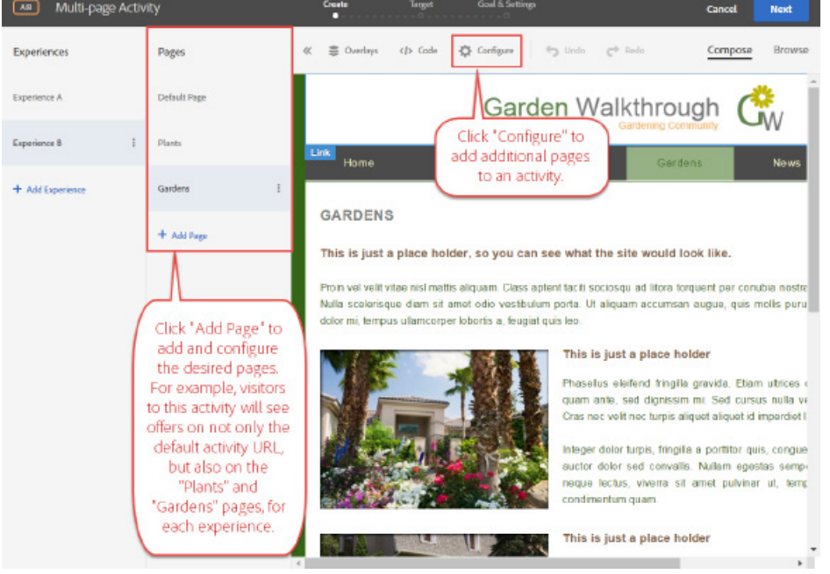
Multipage activities
A multipage activity enables you to deliver consistent messaging and offers over multiple pages, with a design specific to each page.
Multipage activities accomplish this delivery of unified experiences across multiple pages.
Finally, another key use case for multipage activities involves the creation of different layouts for your desktop and non-responsive mobile sites, so you can extend a single activity across both desktop and mobile versions.

Slide 24
Auto-Allocate tests
Auto-allocate tests ensure the most effective experiences are shown more often, through environmental or seasonal changes. More traffic is sent to the best-performing experiences. Less traffic is sent to underperforming experiences. The net result is automated traffic allocation increases overall activity performance while maintaining the integrity of an A/B test, as entrants continue to see that same experience for the life of the activity. It also finds a statistically significant, high-performing experience faster than a manual A/B test, and provides higher average campaign lift than a manual A/B test.

Slide 25
Auto-Allocate tests
If Auto Allocation is so great, why not just make all my A/B tests auto-allocate tests?
Choose auto-allocate when you want to optimize your activity from the beginning and identify the winning experiences as quickly as possible.
Use a manual A/B test when you want to characterize the performance of all experiences before optimizing your site.
Use a manual A/B test when you want pre-specified bounds on factors such as confidence or statistical power, as defined in the Adobe Target Test Calculator
Use Automated Personalization when you want optimization algorithms of the highest complexity.

Slide 26
Auto-Allocate tests
If Auto Allocation is so great, why not just make all my A/B tests auto-allocate tests?
Choose auto-allocate when you want to optimize your activity from the beginning and identify the winning experiences as quickly as possible.
Use a manual A/B test when you want to characterize the performance of all experiences before optimizing your site.
Use a manual A/B test when you want pre-specified bounds on factors such as confidence or statistical power, as defined in the Adobe Target Test Calculator
Use Automated Personalization when you want optimization algorithms of the highest complexity.

Slide 27
Auto-Allocate tests
How to Implement?
Create from scratch
Convert an existing activity
The algorithm begins automatically allocating traffic once at least two of the experiences in the activity have a minimum of 1000 visitors and 50 conversions. From that point onwards, the allocation is evaluated each hour, and readjusted whenever there is a relative difference of at least 5% between the conversion rates of the experiences

Slide 28
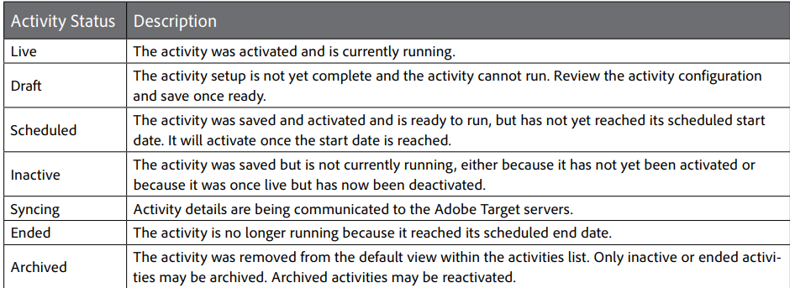
Managing Activities
In the Activities list, activities may be sorted by a variety of filters to find your activities more easily.

Slide 29
Composing Experiences
VEC Actions
Actions for Text and Images
Actions for Links

Slide 30
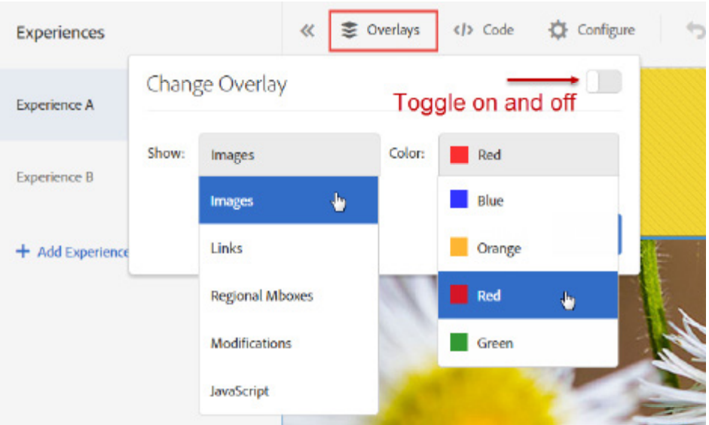
Changing Overlays
The Change Overlay feature enables you to color-code elements, making it easier for you to locate them as you create your experiences. To enable Change Overlay, select the type of element you want to highlight, then select the color in which you would like it to be highlighted, and finally toggle overlays to “on.”

Slide 31
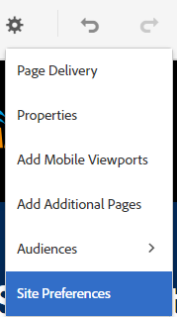
Configuring the VEC
You also know that when you click on the Configure icon at the top of the VEC, you can view or modify the main activity URL, as well as create multipage activities. In this section, we consider some of the additional options available in that location.

Slide 32
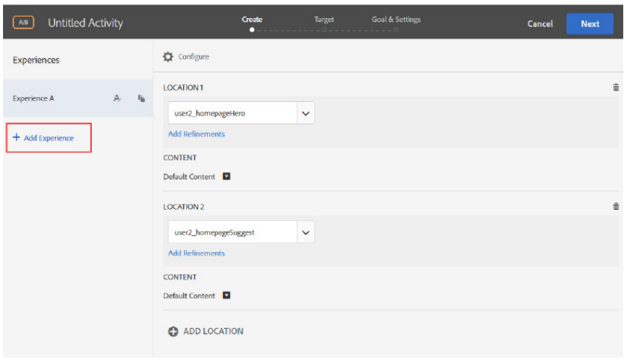
Form-based Activity Creation
Activity creation through the Form-based Experience Composer (FEC) is available for marketers who want to construct experiences based on named locations (regional mboxes).

Slide 33
Form-based Activity Creation
Change Offer lets the user select from HTML offers that were previously saved.
• Change Redirect Offer lets the user select from redirect offers that were previously saved
• Change Image Offer lets the user select from assets that were previously uploaded to the Content Library.
• Change Remote Offer lets the user select from remote offers that were previously saved.
• Use Default Content re-establishes default content for the location.
• Create HTML Offer lets the user create a new HTML offer as opposed to selecting from a previously saved one.

Slide 34
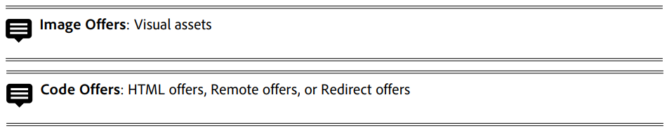
The Content Library
The Adobe Target Content Library enables marketers to manage the offers relevant to their optimization activities. It is integrated with the Marketing Cloud, giving marketers a set of capabilities that extend beyond Adobe Target to leverage assets (image offers) available across solutions.
Key takeaway points regarding the Content Library:
• It is a central repository for managing all assets and offers.
• It allows for easy organization and re-use of content.

Slide 35
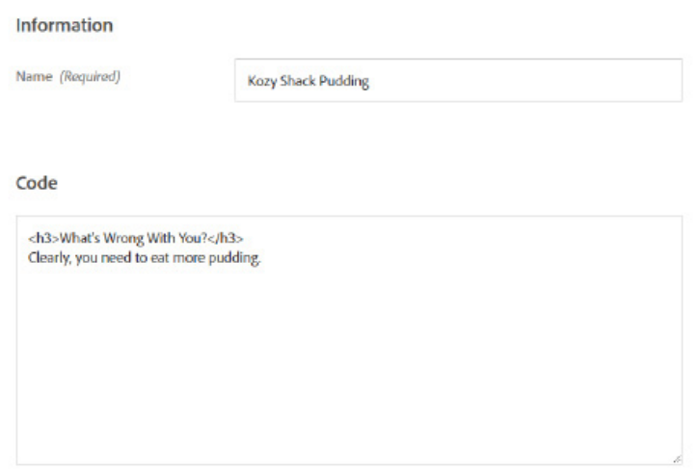
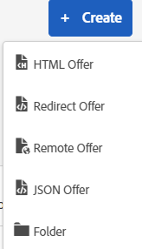
HTML Offers

Slide 36
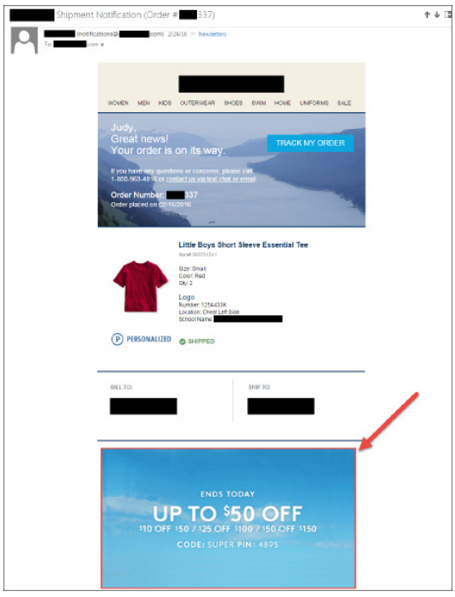
Redirect Offers
Redirect offers may be used in the Form-based Experience Composer (FEC) to either:
• Redirect to a new page when the page loads and the mbox call fires at the top of the page (a URL redirect offer)
• Load an asset (an image redirect offer)
The primary use case for image redirect offers is to enable click-through redirection in a non-web environment, such as in an email, where JavaScript cannot be delivered directly. Tests may also be performed that compare different images served within the email to gauge which content translates to higher lift.

Slide 37
Redirect Offers
In the VEC, use Redirect to URL (as opposed to a redirect offer) to redirect the browser to a different page when the visitor sees that experience. Or, to modify clickthrough links on given elements, use Edit Link

Slide 38
Image Offers
Image offers are visual assets served by Adobe Target during activities. Thanks to fluid integration between Adobe Target and Scene7, having Scene7 enables you to upload image offers and access them using Swap Image in the Visual Experience Composer.
In the absence of Scene7, you would use Edit Source to modify images in the VEC. Read on for additional details and examples.
Submit your Scene7 region, adhoc folder name (the Scene7 folder into which you will be saving assets), and the email address and password you use to log in to Scene7.

Slide 39
Audiences
An audience is a group of people who share a certain characteristic (or set of characteristics).
Examples of audiences could include: Visitors from Google, Visitors from Yahoo, Visitors who purchased in the past, Registered Users, Unregistered Users, Males, Females, Visitors over 50 years of age, and so on.
Activity-Specific Audiences: To create an activity-specific audience, once again, click to change the audience when in the Targeting step of activity configuration.

Slide 40
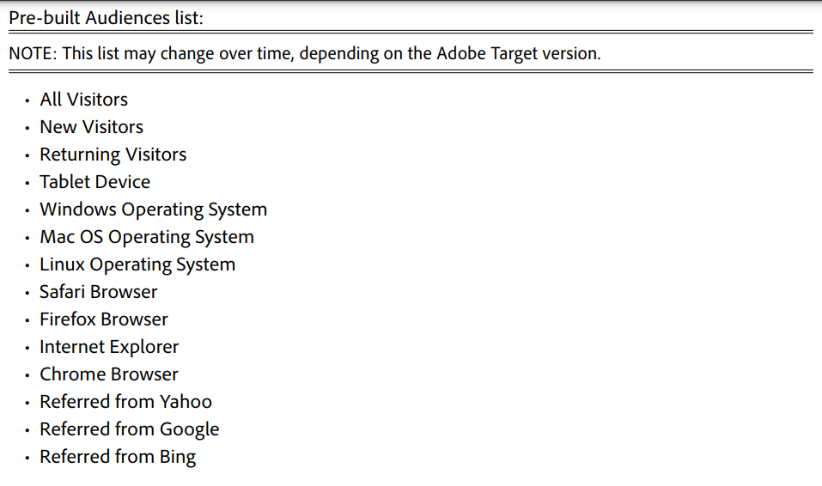
Audience List
The Audiences list holds two types of audiences.
• Pre-built audiences
• Custom audiences

Slide 41
Profile Scripts
Profile scripts are code snippets used to capture and update visitor attributes (which comprise the visitor’s “profile”). They are defined in Adobe Target itself, rather than in the page code (as is the case with other types of profile parameters, called in-mbox profile parameters).
Once created, you must activate the profile script in order for it to be used. Activation tells Target to include that script in its evaluation when it receives mbox requests.
To access Geo information for profile scripts, use profile.geolocation.country, profile.geolocation.state, profile.geolocation.city, profile.geolocation.zip, and profile.geolocation.dma

Slide 42
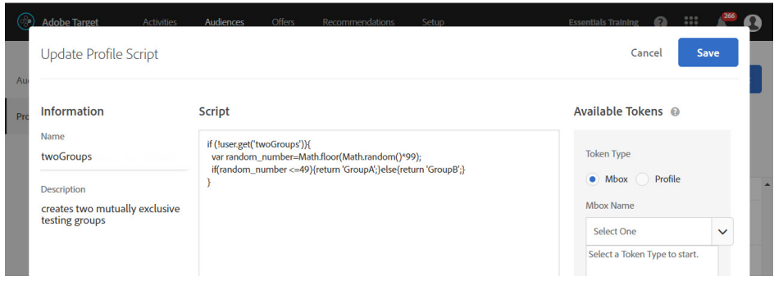
Profile Scripts
Once saved and activated, this profile script may be used to create two mutually-exclusive testing groups. This is useful for situations in which you are running two tests on the same page, and you want to separate the two audiences entering each activity

Slide 43
Profile Scripts
Two Groups:
if (!user.get('twogroups')) { var ran_number=Math.floor(Math.random()*99); if (ran_number <= 49) {return 'GroupA';} else {return 'GroupB';} }

Slide 44
Audience Filter
Audience filters are used to divide visitor traffic and compare experience performance. For example, you may want to know if one experience is better than another, in terms of visitors from one source versus another.
Use audience filters to more precisely interpret your test results by viewing them in the context of visitor segments. They allow you to look at slices of your data—to apply report-filtering criteria.
Use audiences to filter your results and see how different experiences performed in comparison to one another, for different segments of your traffic.

Slide 45
Audience Filter
Audience Filter Recommendations
• Set up audiences before activity launch. For activities that use Adobe Target as the reporting source, audiences must be set up at the beginning of an activity. By contrast, if you are using Adobe Analytics as the reporting source, you do not need to configure audiences prior to activity activation
For activities that use Adobe Target as the reporting source, you cannot set up an activity with zero audiences and then, two weeks into the test, decide you want to add a couple of them. Adobe Target will not retrieve this data retroactively.
• Begin with 2-4 audiences.
• Add as many audiences as you need, but filter every activity by at least two audiences.
• Rename audiences as needed. You can rename audiences in the middle of a live, active activity without problem.

Slide 46
The Sample Size Calculator
Prior to running your manual A/B test, you must plan and determine the sample size in order to know how to correctly interpret the results. Using the Adobe Target Sample Size Calculator correctly will increase your likelihood of detecting true results.
https://experienceleague.adobe.com/tools/calculator/testcalculator.html
Input the base Conversion Rate from the site area
• Input the visitors per day to the site area
• Input the number of experiences (Use the Bonferroni correction for three or more experiences)
• Input the minimum detectable lift
• Input the confidence level
• Input the power level
• Output: number of days/weeks required to run the test

Slide 47
The Sample Size Calculator
Confidence Level
Confidence represents the likelihood of avoiding a false positive, the probability you will avoid measuring a lift if there is none. It determines the false positive rate. For example, the default confidence value is 95%. This means you will allow a threshold of up to 5% false positives.
Statistical Power
Statistical power represents the likelihood of correctly detecting a true positive. In this sense, it is the inverse of confidence: whereas confidence can be thought of as the likelihood of avoiding a false positive, statistical power is the likelihood of correctly detecting a true positive.

Slide 48
The Sample Size Calculator
Minimum Detectable Lift
The minimum detectable lift is the smallest lift you can reliably detect, statistically, for a given sample size. The more volume you have, the lower lift you can accept. Everyone wants to detect as small of a lift as possible. You have to have a lot more data, the smaller the lift you want to detect. The closer the two samples look to each other, you have to have a lot of data to determine the lift between them is actually real.

Slide 49
The Sample Size Calculator
Guidelines for using the calculator correctly
• Run your activity for the length of time determined by the calculator
• Do not end the test early UNLESS you have overwhelmingly high confidence, such as 99.9% confidence for at least a week. Stopping a test early dramatically increases false positives.
• Do not peek at the test prior to its calculated end. Each check of the test introduces the temptation to act based on incomplete results, which means another chance for a false positive.
• To correctly interpret the test, compare your results to what was provided by the calculator: If your measured lift and confidence level were above what you set as the threshold in the calculator, then you can correctly call a winner.
• Expect to mostly end up with neutral results.
• Finding a negative result is still important information gained, and it only impacted your users for a limited period of time.
• Finding a positive result means that you can roll out those results and reap the benefits of it.

Slide 50
The Sample Size Calculator
The confidence level is based on standard statistical significance calculations using the “student's t-test,” which assesses whether the means of two groups are statistically different from each other. This is the same calculation used in presidential polls. For example, when commentators remark, “This candidate has 54% of the vote, and the other candidate has 46%, with 95% confidence, +/- 3%,” they are referring to the same calculation for confidence that is used in Target Premium and Standard.

Slide 51
The Sample Size Calculator
Confidence Interval
The confidence interval is a range within which a metric’s true value can be found, for a given confidence level. Adobe Target always uses a 95% confidence level to calculate confidence intervals. One major implication of this is that if the confidence level for a given experience falls below 95%, no conclusions may be drawn yet regarding that experience’s lift.
In the case of the confidence interval, if it ever corresponds to a lift that crosses zero—one that includes both negative (red) and positive (green) results—that means there is no guarantee that the lift isn’t 0%. Generally speaking, you will want to wait to draw conclusions until the confidence interval is narrow enough such that the corresponding lift doesn’t cross zero.

Slide 52
Target Reporting - Conversions, Confidence, and Lift
Conversion Rate shows the percentage of visitors who actually reach the goal during an activity.
• Lift—also called Conversion Rate Lift, or CR Lift—compares the conversion rate for each experience against that of the control experience. Note that it is not uncommon to see negative lift as well as positive lift.
• Confidence, or the Confidence Level, denotes the likelihood that a given experience’s lift is statistically significant. Suppose you have 8.7% lift, with 97% confidence. When you evaluate your test at sample size per the calculator, this means there is a 97% probability that the lift you measured is not due to chance, but instead is statistically significant.

Slide 53
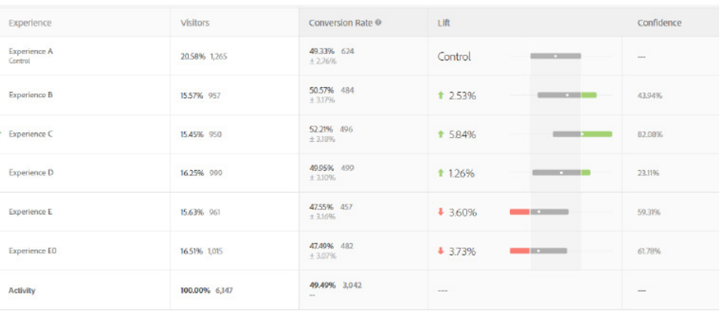
Target Reporting - Conversions, Confidence, and Lift

Slide 54
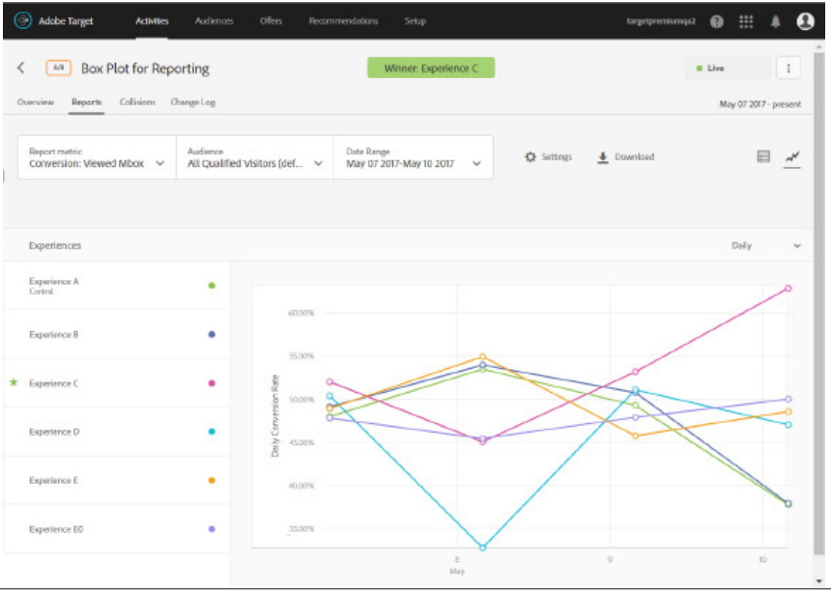
Target Reporting
Adobe Target reports make it easy to see how well your different experiences are accomplishing your activity’s objective. This is because they highlight the key success metric relevant to the goal you defined for the activity. Consider the following results, keeping in mind any report interpretation should only be performed once the test duration has been met.

Slide 55
Target Reporting
Winning Experiences
Winning experiences are flagged with a star and a callout at the top of the report, making them easy to identify.
They are flagged strictly based on lift as compared to control, without taking factors such as the sample size calculator into consideration.
Calendar
Adobe Target’s default date range for reporting is something called “Life of Activity.” Life of Activity is defined as the time period beginning from the date the activity is first activated, through the date the activity is last deactivated. If the activity is currently activated (that is, if there is no deactivation date), then the “end” date simply reflects the current date.

Slide 56
Target Reporting
Downloading Report Data
For activities that use Adobe Target as the reporting source (as opposed to Adobe Analytics), users may download the Metrics report or the Order Details report. The Metrics report includes all metrics defined for the activity, both Goal and Additional Metrics.
For reports from an activity driven by Adobe Analytics data, marketers would use native capabilities within Adobe Analytics native capabilities in order to download data.

Slide 57
Target Reporting
Changing from Running Averages to Daily Numbers
In the graph view, metrics default to displaying running averages. For example, conversion-based metrics default to displaying Running Conversion Rate, whereas revenue-based metrics default to displaying Running Revenue per Visitor (RPV). Engagement-based metrics default to displaying the running average for the metric in question.
Can you change to a metric other than Running Conversion Rate, Running RPV, or the running engagement metric? Absolutely. To change from cumulative numbers to daily values, select from the drop-down menu.
Viewing Data by Audiences
On the Reports page, click the Audiences drop-down to filter your activity results by a different audience.

Slide 58
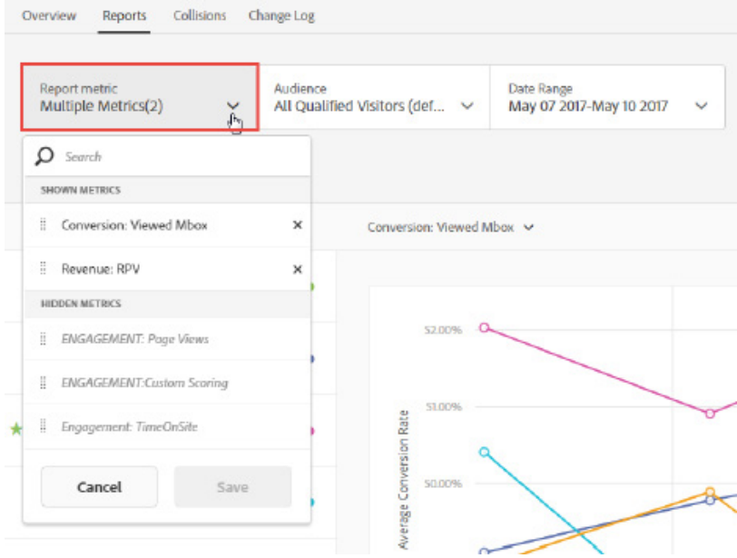
Target Reporting
Changing Metrics
To change metrics, click the Report metric drop-down arrow. Select a different metric to recalibrate the report according to it.
The metrics that appear in this drop-down list are highly variable from one activity to another, as they reflect the goal and additional metrics configured for the specific activity in the final step of activity configuration

Slide 59
Target Reporting
Be aware of the following information as you work with multiple metrics in reports:
• The ability to view multiple metrics is available A/B and Experience Targeting (XT) activities only. You cannot view multiple metrics in reports for Auto-Allocate and Auto-Target A/B activities.
• You cannot add more than 20 metrics to a report for an activity that uses Analytics for Target (A4T). You can add as many metrics as you have in your activity to reports for activities that do not use A4T.
• You cannot use the Download option to download reports to CSV if you have selected multiple metrics. You must select a single metric to enable the Download option.
• You cannot view multiple metrics for activities created before the July 2015 Target release

Slide 60
Target Reporting
Metric Types
When you change metrics on a Target report, you may change to one of three potential metric types:
• Conversion
• Revenue
• Engagement
This is relevant because additional options available to you will vary depending on the metric type chosen.

Slide 61
Target Reporting
Whether in graph or table view, click Settings to access Report Settings that allow you to modify aspects of the report such as counting methodology, control experience, extreme values, and environment.
Counting Methodology
The default Counting Methodology is based on Visitors, but you may change this to Visits or Activity Impressions.
A Visitor is a unique participant in an activity, for the life of the activity. Adobe Target keeps track of visitors through the visitor’s cookie. If someone visited your site once per day, for three days, they would still be counted only once. This is the most common counting methodology used in reports.
• A Visit is a unique participant’s session on your site. A session’s end is determined after 30 minutes of inactivity on the site. If someone visited your site once per day, for three days, they would be counted as having had three visits

Slide 62
Target Reporting
• An Activity Impression is counted every time a page is loaded. A single visit may include several impressions of, for example, your homepage. Note (1) there must be an mbox on a page in order for a page view to be counted, and (2) each mbox on a page will be counted once. If there are three mboxes on a page, the page view count will increment by three.
The Control Experience
Change Control to select another experience as the basis for comparison (the basis for calculating lift).

Slide 63
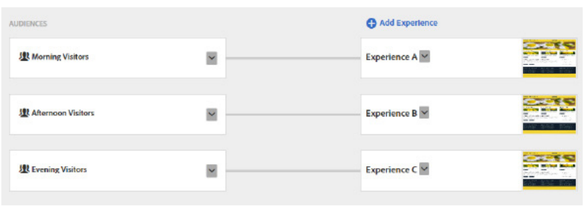
Experience Targeting
Experience Targeting (XT) activities, by contrast, allow you to use experience-level targeting to to show different experiences to the same visitor if they arrive with criteria that qualify them for those different experiences.

Slide 64
Experience Targeting
In an experience targeting activity, if the visitor ever converts, their conversion is attributed to the last viewed experience.
XT activities match visitors starting with the first experience and moves downwards through subsequent experiences, in order of experience design. If you would like to change this behavior, adjust the priorities for each experience.
If the audience targeting criteria for each experience are not designed to be mutually exclusive, consider the impact of defining more-inclusive experiences higher or lower than others to ensure the behavior is one you expect and desire.
In terms of reports, the layout and function of XT reports is the same as for A/B tests. However, you may see the same visitor counted in multiple experiences if they qualified for them, whereas in A/B tests, you will only ever see a single visitor counted in a single experience for that activity

Slide 65
Multivariate Test
Multivariate tests are extremely valuable when you want to test three or more elements on your page to determine which of those elements are really impacting conversion. What is an “element?”
Examples include:
• Headline on a page
• Main image on the page
• Promotion
• Call to action
• Descriptive text
Benefits of MVTs
The power behind multivariate testing is you select the elements and alternative content you want to test, and Adobe Target handles the experience creation. For example, suppose you wanted to test four elements on a particular page, and you had three different versions of each of those elements.

Slide 66
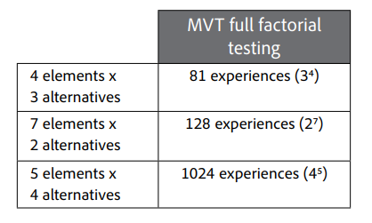
Multivariate Test
For Adobe Target MVTs, input the elements and alternatives of interest, and Target outputs the full factorial array of experiences that need to be tested in order to determine winning experiences and significant locations and content.

Slide 67
Multivariate Test
Multivariate Test Results Using Target
When you perform a multivariate test in Target, you will still see the same results you would usually see when running an A/B test. Namely, you will see metrics that evaluate factors such as: How is each experience performing? How many visitors have seen them? What’s the conversion rate and lift for each? And so on. These appear within the "Experience Performance Report." But in addition to standard A/B reporting in the Experience Performance Report, you also have:
• the ability to filter by the "Best 5" and "Worst 5" experiences, which is helpful considering the large number of experiences you will likely be dealing with.
• a separate report called the "Location Contribution Report," which surfaces the test location that contributes the most to conversion, as well as an offer-level comparison that highlights the best-performing offer.

Slide 68
Multivariate Test
MVT Guidelines Follow these planning guidelines for more successful MVTs:
Select elements you believe will have the strongest impact on the results.
Keep elements independent of each other. This means you should not test your layout and content in the same activity.
Make sure you have at least three elements to test. If you have fewer than three, run an A/B test instead.
For each element, it is recommended to have alternatives that are significantly different from each other.
Prepare content ahead of time. Planning an MVT requires coordination across groups as the optimization or campaign manager needs to work closely with the creative or design group to realize the offers they would like to roll out during the test.

Slide 69
Multivariate Test
MVT Guidelines Follow these planning guidelines for more successful MVTs:
Create a test plan. Avoid modifying a test after it has been activated. It is not advisable to edit a test once it is live and data starts being collected.
Consider the traffic requirements. MVTs require significant traffic (and time) to generate meaningful results
Check the HTML code on your activity page. Ensure the HTML elements do not have duplicate DOM IDs

Slide 70
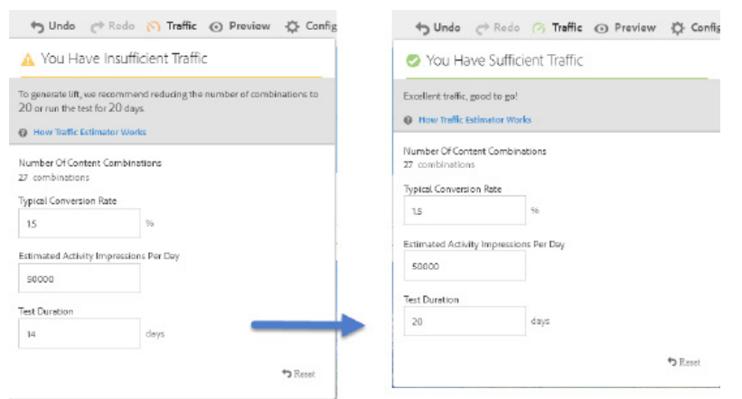
Multivariate Test
The Traffic Estimator uses several variables to determine the adjustments needed for a successful test. It will provide recommendations as to how to adjust the number of combinations or the length of the test to ensure success.

Slide 71
Multivariate Test
Interpreting MVT Results
There are two reports available for MVTs:
• Experience Performance
• Location Contribution
Experience Performance Report
The Experience Performance Report provides results similar to that of an A/B test, including
• Comparison of experience performance
• Visitors, Conversion Rate, Confidence Interval, Lift, and Confidence

Slide 72
Multivariate Test
Location Contribution Report
In addition to the Experience Performance report, MVTs also provide a Location Contribution report.
The top half of this report shows influence details. At a glance, the marketer can assess:
• Relative influence of each element
• Elements that impact conversion the most
The bottom half of the report shows Offer details. At a glance, you can determine:
• Conversion rate, lift, and confidence of each offer
• Which offers are most successful

Slide 73
Auto-Target Tests
A fully automated test that lets machine-learning optimize your marketer-defined experiences. “Marketer defined experiences,” as discussed previously, and refers to the experiences the marketer manually sets up in the first step of the activity workflow.
Unlike an AB test, where the objective is to find a single winner (a single winning experience), Auto-Target will automatically determine the best experiences for a given visitor (based on their profile) to deliver a highly personalized experience.
Unlike an A/B test, where the experience allocation for a given visitor is sticky, Auto-Target instead optimizes the specified business goal over each session, whether this means serving the same experience that the visitor was served last time, or whether it means serving a new one.
Auto-Target is powered by a modified version of Automated Personalization

Slide 74
Auto-Target Tests
Considerations
There are a few important considerations to keep in mind when using Auto-Target:
You cannot switch a specific activity from Auto-Target to Automated Personalization, and the opposite way.
You cannot switch from Manual traffic allocation (traditional A/B Test) to Auto-Target, and the opposite way after an activity is saved as draft.
One model is built to identify the performance of the personalized strategy versus randomly served traffic versus sending all traffic to the overall winning experience. This model considers hits and conversions in the default environment only.
Traffic from a second set of models is built for each modeling group (AP) or experience (AT). For each of these models, hits and conversions across all environments are considered.
Use a minimum of two experiences.

Slide 75
Automated Personalization
Automated Personalization (AP) activities in Adobe Target combine offers or messages, and uses advanced machine learning to match different offer variations to each visitor based on their individual customer profile to personalize content and drive lift.
Automated Personalization uses a Random Forest algorithm, a leading data science ensemble method.
Automated Personalization can be valuable in the discovery phase of testing. It is also useful to allow machine learning to determine the most effective content when targeting diverse visitors.
Automated Personalization can adapt to changes in visitor behavior, it can be run without a set end date to provide ongoing lift and personalization. This mode is sometimes referred to as “always-on.”

Slide 76
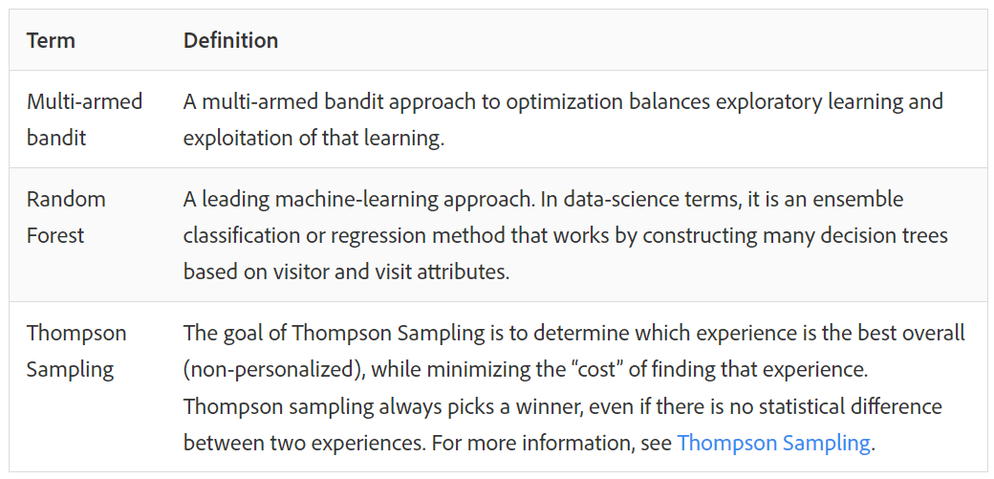
Automated Personalization
Common terms in Automated Personalization

Slide 77
Automated Personalization
- Automated Personalization uses a Random Forest algorithm to personalize
- The personalization model optimizes for each visit
- The personalization model adapts to changes in visitor behavior
- The model continually optimizes a single goal metric
- Target automatically collects information about visitors to build the personalization models
- Target automatically uses all Adobe Experience Cloud shared audiences to build the personalization models

Slide 78
Automated Personalization
Marketers can upload offline data, propensity scores, or other custom data to build personalization models
Offline data, such as CRM information or customer-churn propensity scores, can be incredibly valuable when building personalization models. There are several ways to input data in Automated Personalization (AP) and Auto-Target personalization algorithms.
mbox parameters
Profile parameters
Server-side APIs for profile update

Slide 79
Auto-Target and Automated Personalization: Similarities
The Auto-Target algorithm continually optimizes for a single goal metric, which is conversion based.
Automated Personalization and Auto-Target are similar in that experiences are not sticky.
The underlying models are rebuilt every 12 hours using the latest visitor behavior data to ensure it always remains current with changing visitor preferences. The multi-armed bandit (MAB) ensures we spend a small fraction of traffic (20%) to prevent over-exploitation of learning and to keep learning new trends.
The platform automatically uses all Marketing Cloud Shared Audiences for model-building purposes

Slide 80
Auto-Target and Automated Personalization: Differences
Auto-Target frequently requires less traffic than Automated Personalization for a personalized model to build.
For Auto-Target, simple rules of thumb can be used to understand traffic requirements:
When Conversion is your success metric: 1,000 visits and at least 50 conversions per day per experience, and in addition the activity must have at least 7,000 visits and 350 conversions.
When Revenue per Visit is your success metric: 1,000 visits and at least 50 conversions per day per experience, and in addition the activity must have at least 1,000 conversions per experience.
Auto-Target has full-fledged setup functionality.
Auto-Target provides an extensive online testing framework.
Auto-Target uses a modified version of Random Forest and also uses an extended version of the multi-armed bandit from Automated Personalization that ensures all experiences deliver positive lift. This approach allows us to remove the choice of manual algorithm selection to make sure the marketer benefits from the very best decision the system could possibly take.

Slide 81
Auto-Target and Automated Personalization: Differences
When should you choose Auto-Target over Automated Personalization?
There are several scenarios in which you might prefer to use Auto-Target over Automated Personalization:
If you want to define the entire experience rather than individual offers that are automatically combined to form an experience.
If you want to use the full set of Visual Experience Composer (VEC) features not supported by Auto Personalization: the custom code editor, multiple experience audiences, and more.
If you want to make structural changes to your page in different experiences. For example, if you want to rearrange elements on your home page, Auto-Target is more appropriate to use than Automated Personalization

Slide 82
Questions
1. Alok has setup an A/B test for users who are not part of any other test within the same domain. In which part of the audience section can you create this segment?
Custom
Visitor Profile
Audience Exclusion
User Profile
2. Mr. Singh has to setup a test to validate changes to two different elements of the home page which is receiving lots of traffic. Element A – Hero Banner Element B – Header Link In total, each of the elements had two versions including the default control version. Key stakeholders from the marketing team want to understand whether change in hero banner had a greater impact on the conversions than changing the header link? In this situation, which of the following test would be appropriate to identify the impact of elements.
A. Experience Targeting
B. A/B
C. MVT
D. Automated Personalization

Slide 83
Questions
3. An A/B test was setup by Mr. Singh which was planned to run for three weeks with sample size 60,000 for each experience. These numbers were derived using Adobe recommended sample size calculator. After 10 days of the activity going live, below results were observed. What should be the recommendation to key stakeholders? Visits,Lift,ConfidenceControl
Exp A - 35,000 2% 90%
Exp B - 38,000 -21% 99%
A. Continue the test until estimated sample size is reached for each experience.
B. Retain Exp. A since negative lift (-21%) is observed for Exp. B with 99% confidence
C. Wait until both the experiences reach 95% + confidence levels to interpret results
D. Stop sending traffic to Exp. B & divert 100% traffic to Exp. A

Slide 84
Questions
4. There are two campaign banners set up on the home page of a leading e-Commerce site which also has Adobe Analytics configured on the site. Mr. Singh has setup an A/B test to validate the campaign performance where adding product to cart is the primary goal of the test. Key stakeholders want to understand users from which campaign contributed more to the conversions? How can you setup the goal to understand the expected behavior?
A. Setup link tracking in Analytics & use the click event as goal
B. Add campaign click as dependency in advanced settings while creating the activity
C. In global configuration under setup, add campaign click as dependency for primary goal
D. Add a secondary goal for campaign click and configure order of goal execution

Slide 85
Questions
5. An AP test was setup by Mr. Singh on the home page of a leading financial institution. The test audience included users from geo location North America & the configuration included variations across five different elements i.e. CTA, Hero Banner, Header Link, Footer Link, & Banner Message. After setting up the test Mr. Singh had shared the Preview URL links with leading marketing folks across each region to get a sign-off before going live with the activity. One of the stakeholders intended to validate the activity to understand whether someone from North America was actually qualifying for the test. What needs to be done in this case to meet the stakeholder expectation?
A. Preview URL shared will allow you to validate audience qualification by default
B. Set the activity to live with actual audience to validate
C. Set the activity to live with QA audience(URL param=”target”) to validate
D. Set the activity to live & use multiple audiences which includes QA & actual audience to validate.

Slide 86
Questions
6. Mr. Singh has setup an experience targeting test which has three different experiences. The activity went live last week and based on the observation from one of the key marketing folks, there was an issue where he was qualifying incorrectly. Below is the audience criteria along with the experience. How should the order of the experience-audience pair be configured while setting up the test?
Experience A:Users coming from “Gurgaon” location
Experience B:Users coming from “Haryana”
Experience C:Users coming from “India”
A. Exp. B | Exp. C | Exp. A
B. Exp. C | Exp. B | Exp. A
C. Exp. A | Exp. C | Exp. B
D. Exp. A | Exp. B | Exp. C

Slide 87
Questions
7. Based on the calculations derived using sample size calculator, Mr. Singh figured out that to run an A/B test on the campaign landing page to validate two different versions of CTA text would take 21 days. The activity was configured and was set to live. After two weeks it was assessed that the test duration is actually increasing and it would take more time than initially estimated. What are the possible reasons for increase in the test duration?
A. Under estimation of traffic numbers
B. Over estimation of traffic numbers
C. Increased estimated lift
D. Due to high volume of traffic observed while promoting special offers during the last two weeks

Slide 88
Questions
Try this:
8. You want to test two different experience versions with 50% discount and BOGO offer for all visitors on website. Each experience should be created for two different languages for geotargeting.

Slide 89
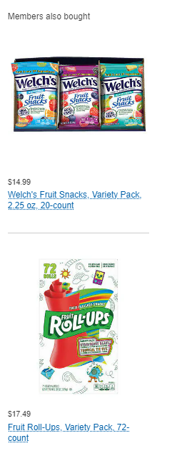
Recommendations
Adobe Target Recommendations activities automatically display products, services, or content that might interest your visitors based on previous user activity, preferences, or other criteria. Target Recommendations helps direct visitor to relevant items they might otherwise not know about.
Recommendations helps you:
Create sophisticated criteria (rules) to automate recommendations
Automatically display the recommendations by using a few JavaScript snippets
Test and optimize the recommendations criteria and designs that display the recommendations
Report on the results of your recommendations activities

Slide 90
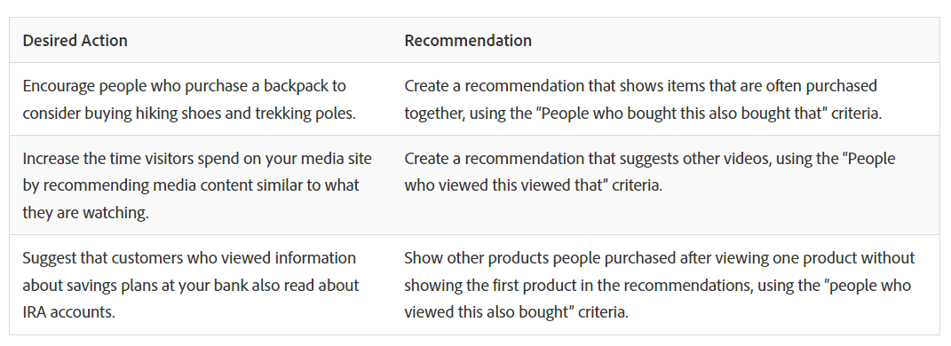
Recommendations

Slide 91
Recommendations
Publishing: Web publishers use Target Recommendations to recommend articles to site visitors and drive increased engagement.
Video Tutorials: Adobe Creative Cloud uses Target to recommend video tutorials to Photoshop users in the Photoshop application.
Gaming: Gaming companies use Target to recommend games and content to users on their consoles.
B2B Sales: Business-to-business companies use Target to recommend videos, whitepapers, and blog posts to B2B prospects; deliver downloads; and provide help to existing customers.
Travel: A German travel booker uses Target to recommend hotels and more to travelers.
Retail: A leading B2B retailer uses Target to recommend top categories and products to return visitors in the browser and in its mobile app.

Slide 92
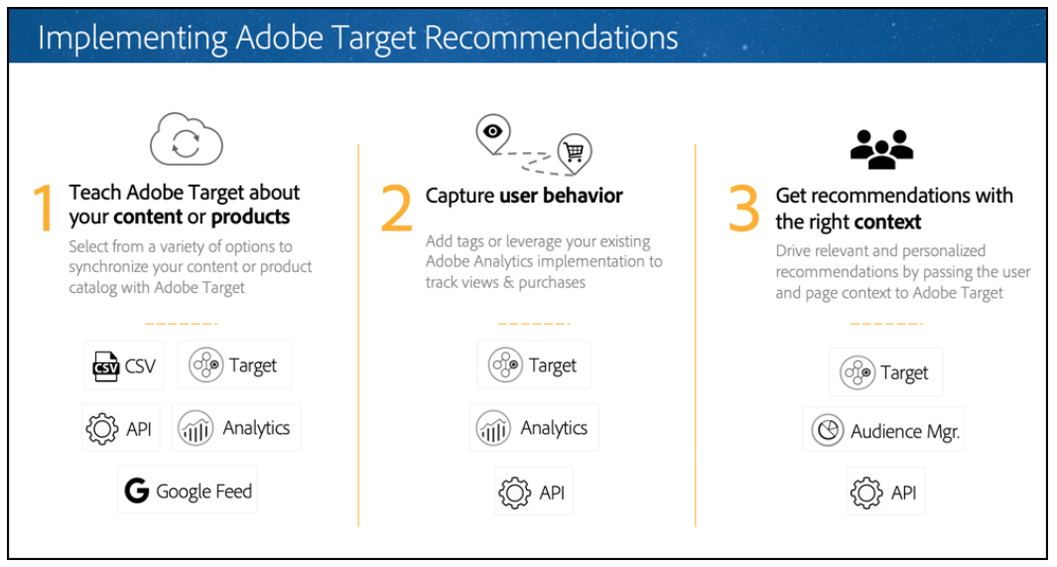
Recommendations
Steps involved in creating your recommendations implementation

Slide 93
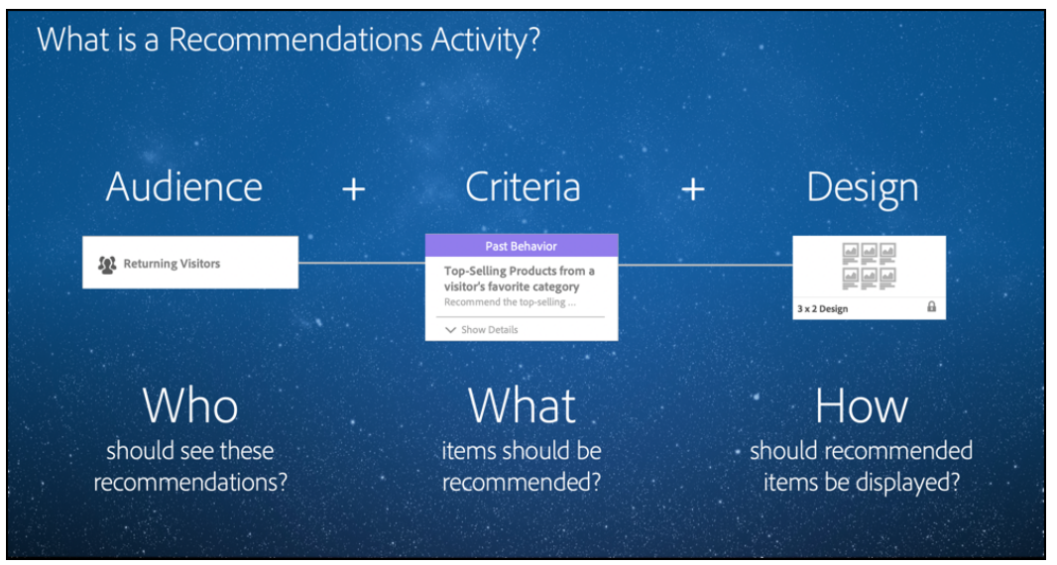
Recommendations

Slide 94
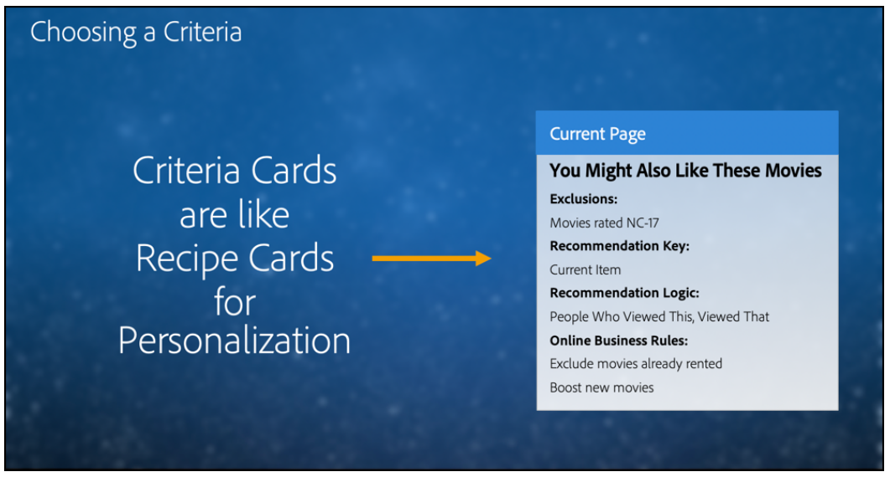
Recommendations

Slide 95
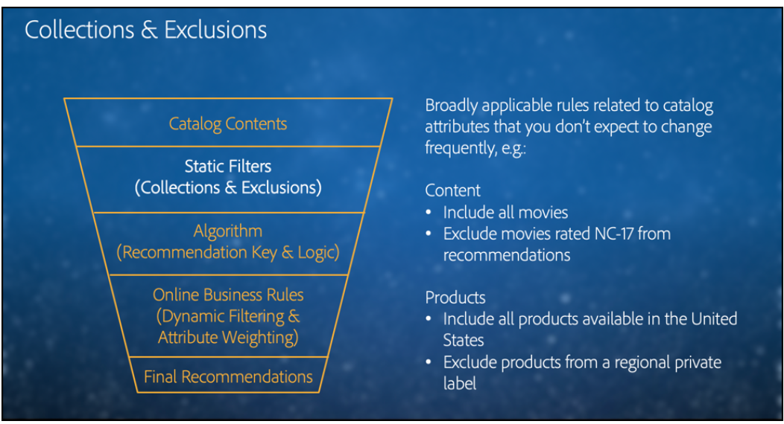
Recommendations

Slide 96
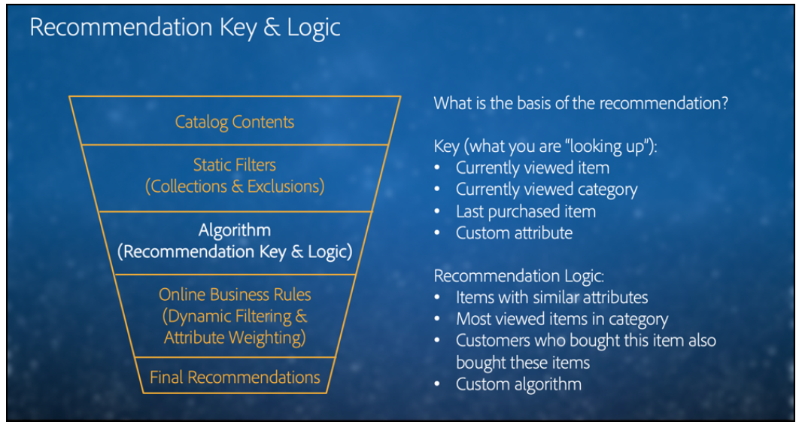
Recommendations

Slide 97
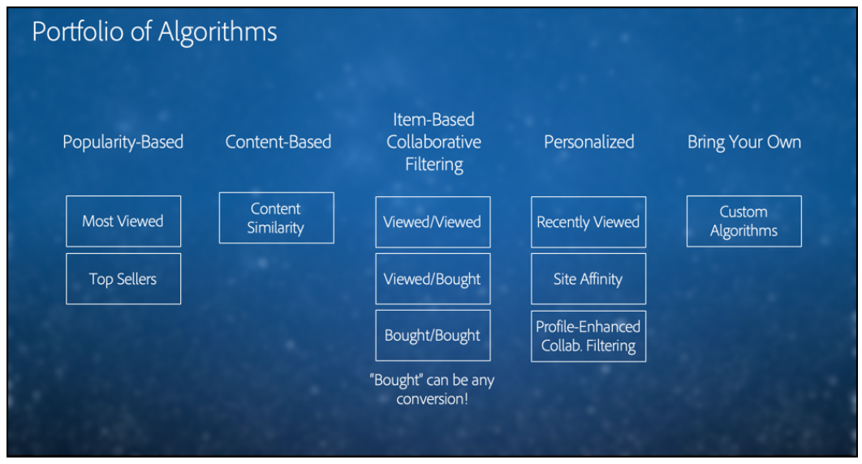
Recommendations

Slide 98
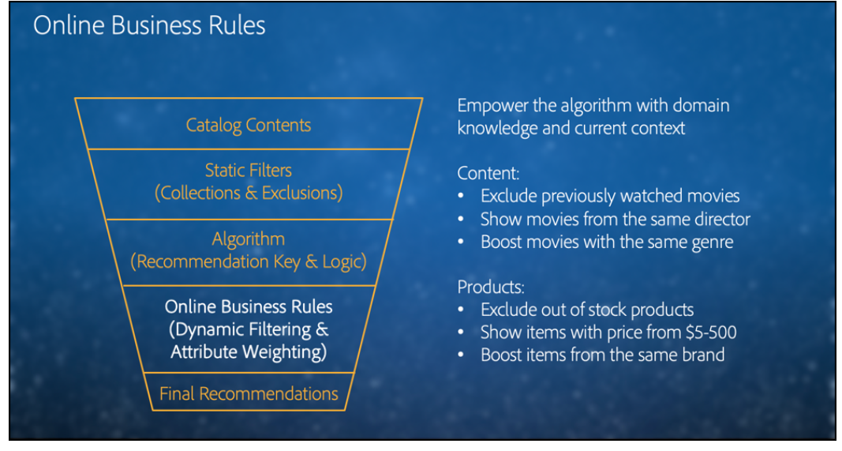
Recommendations

Slide 99
Entities
Entities refer to the items you want to recommend. Entities can be anything such as products, content (such as articles, slide shows, images, movies, and tv shows), job listings, restaurants, and so forth.
Recommendations displays items from your collections according to criteria you set up.
Use Entities to:
Set up your collections
Use feeds to get entity or content information into your recommendations
Set exclusions to prevent certain items from displaying in your recommendations
Entity attributes
Use entity attributes to pass product or content information to Adobe Target Recommendations.
Entities refer to the items you want to recommend. Entities can include products, content (articles, slide shows, images, movies, and television shows), job listings, restaurants, and so forth.

Slide 100
Entities
Custom entity attributes
Use single- and multi-value custom entity attributes in Adobe Target Recommendations to define additional information about items in your catalog.
Limits
You can include up to 100 custom entity attributes to define additional information about items in your catalog. For example, you might create a custom attribute called entity.genre to define a book or movie.
Using targetPageParams
Using CSV
3. Using APIs

Slide 101
Entities
Feeds:
Use feeds to get entities imported into Adobe Target Recommendations. Entities can be sent using CSV files, the Google Product Search feed format, and Adobe Analytics product classifications.
Feeds let you pass Entities or augment your mbox data with information that is either unavailable on the page or is unsafe to send directly from the page, such as margin, COGS, and so on.
Feeds let you pass detailed item information into Recommendations, such as product ID, category, name, message, and other attributes.
These pieces of data about each item can then be used to:
Display values in designs
Define criteria inclusion rules
Sort items into different collections
Apply exclusions to recommendations

Slide 102
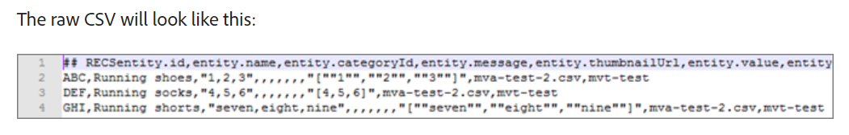
Entities
CSV:
You can create a .csv file using the Adobe proprietary CSV upload format. The file contains display information about the reserved and custom attributes for your products. To upload attributes specific to your implementation, replace CustomN in the header row with the name of the attribute you want to use.

Slide 103
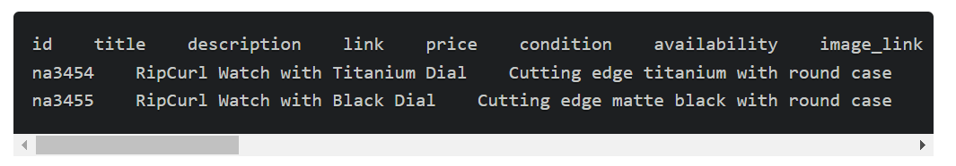
Entities
Google
The Google Product Search feed type uses the Google format.
Most retailers upload products to Google, so when a visitor uses the Google product search, their products display. Recommendations follows Google’s specification exactly for entity feeds. Entity feeds can be sent to Recommendations via .xml, .txt, or .tsv, and can use the attributes defined by Google.

Slide 104
Entities
Analytics Product Classifications
The Analytics Product classification is the only classification available for recommendations.
Before importing entity data into Recommendations using Analytics product classifications, be aware that this is not the preferred method.
Be aware of the following caveats:
Updates to entity attributes incur an additional delay of up to 24 hours.
Target supports Product Classifications only. The Analytics product SKU must map to the same level as the Recommendations entity.id. Custom Analytics Classifications can be engineered using Adobe Consulting Services. Contact your Account Manager with questions.

Slide 105
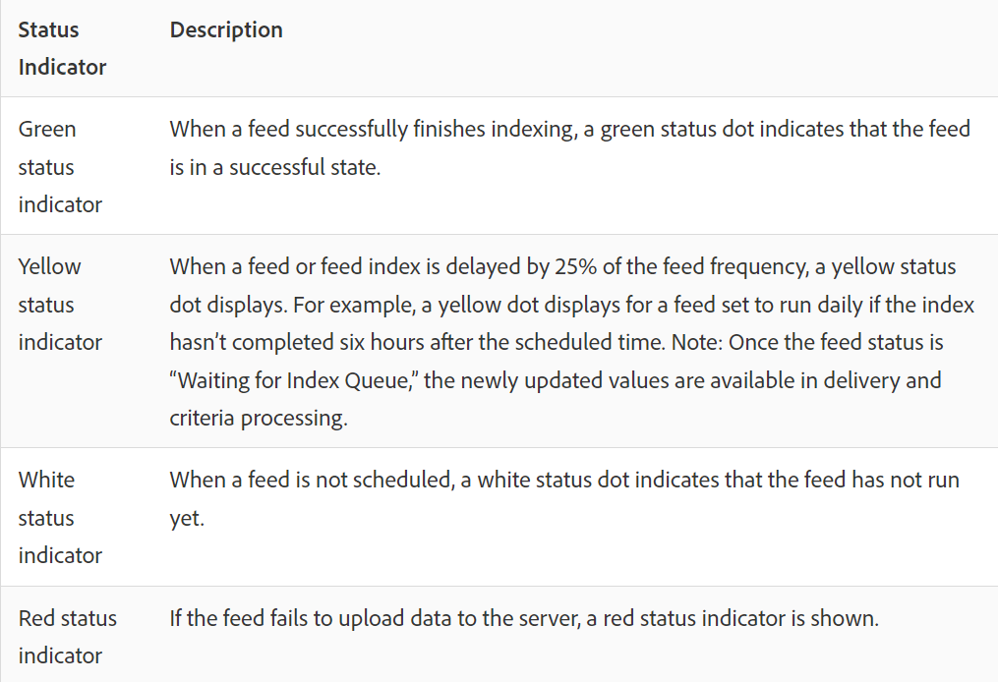
Entities
Feed Status Indicators

Slide 106
Entities
Catalog Search
The Catalog Search page in Adobe Recommendations helps you locate the products or content in your catalog. The most basic task you can perform on this page is to search for an item. In addition, you can change the environment, save search results to collections or exclusions, add filter facets, and modify columns in the table, add new search facets, and more.

Slide 107
Entities
Collections
A collection is a set of products or items that are eligible for a recommendation. A collection is defined by specifying the conditions that must be met by items to be part of it.
Commonly, a collection is a set of similar or related items, such as a single product collection. However, you can group whichever items into a category that makes sense to your business, such as products in a certain price range or color or items that are likely to be interesting in a particular geographical area.
Collections are rebuilt or updated every time each criteria runs.
You can group your items into catalogs, then create separate recommendations for each collection.
Inclusion criteria allow you to do similar things as a collection, but they must be set up every time you create an activity

Slide 108
Entities
Exclusions
A collection is a set of products or items that are eligible for a recommendation. A collection is defined by specifying the conditions that must be met by items to be part of it.
Commonly, a collection is a set of similar or related items, such as a single product collection. However, you can group whichever items into a category that makes sense to your business, such as products in a certain price range or color or items that are likely to be interesting in a particular geographical area.
Collections are rebuilt or updated every time each criteria runs.
You can group your items into catalogs, then create separate recommendations for each collection.
Inclusion criteria allow you to do similar things as a collection, but they must be set up every time you create an activity

Slide 109
Entities
Create an exclusion in Adobe Target Recommendations to prevent products or content from being recommended to visitors. An exclusion is a subset of products or content that should not be recommended to visitors.
Exclusions are available across the entire account. Some examples of times you would use exclusions include:
Products that have been discontinued
Fall/Winter catalog is now the only catalog that should be present online. Any item from the Summer catalog is no longer available for purchase.
Items that might be inappropriate to recommend on most pages/screens (adult products, NC-17 movies, etc.)
Products with incomplete metadata fields (missing thumbnail, price, or other important metadata)
Products that should never be recommended (maybe a SKU exists in the system for something but it isn’t a purchasable item, or maybe it is a fake SKU for the QA team to simulate a purchase without actually ordering something, etc,)

Slide 110
Criteria
Criteria in Adobe Target Recommendations are rules that determine which products or content to recommend based on a predetermined set of visitor behaviors. Criteria can be based on popular trends, a visitor’s current and past behaviors, or similar products and content.
Algorithm Type
The algorithm type you select determines the available algorithms. There are several algorithm types, which are represented as criteria cards when you set up a Recommendations activity.

Slide 111
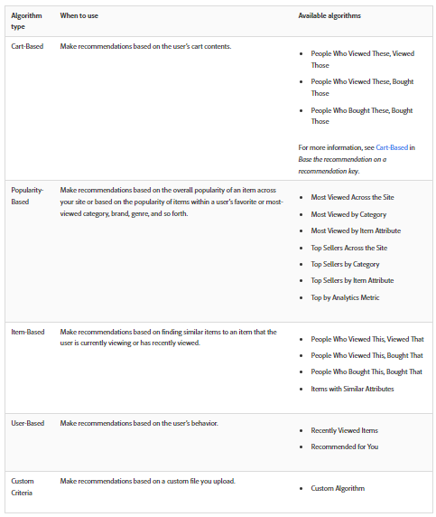
Criteria

Slide 112
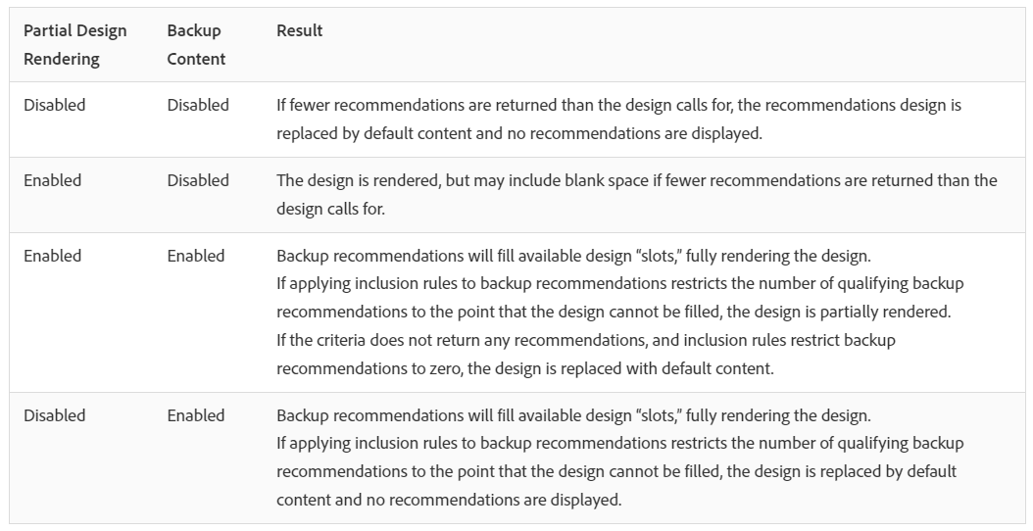
Criteria
Backup Content
Backup Content rules determine what happens if the number of recommended items does not fill your recommendations design. It is possible for Recommendations criteria to return fewer recommendations than your design calls for. As an example, if your design has slots for four items, but your criteria causes only two items to be recommended, you can leave the remaining slots empty, you can use backup recommendations to fill the extra slots, or you can choose to display no recommendations.

Slide 113
Criteria
Content Similarity
Use Content Similarity rules to make recommendations based on item or media attributes.
Content similarity compares item attribute keywords and makes recommendations based on how many keywords different items have in common. Recommendations based on content similarity do not require past data to deliver strong results.
Using content similarity to generate recommendations is especially effective for new items, which are not likely to show up in recommendations using People Who Viewed This, Viewed That and other logic based on past behavior. You can also use content similarity to generate useful recommendations for new visitors, who have no past purchases or other historical data.

Slide 114
Criteria
Inclusion Rules
Inclusion rules are optional; however, setting these details gives you more control over the items that appear in your recommendations. Each detail you configure further narrows the display criteria.
For example, you can choose to display only women’s shoes that have an inventory of more than 50 and a price between $25 and $45. You can also weight each attribute so those items that are more important to your business are most likely to appear.
As another example, you can choose to display job openings to visitors who visit your site only from certain cities and who have the required college degrees.
Inclusion rule options vary by industry vertical. By default, inclusion rules are applied to backup recommendations.

Slide 115
Criteria
Attribute Weighting
You can add multiple rules to “nudge” the algorithm based on important information or metadata about the content catalog so that certain items are more likely to be shown.
For example, you can apply a higher weighting to on-sale items so they appear more often in the recommendation. Non-sale items are not completely excluded, but they appear less often. Multiple weighted attributes can be applied to the same algorithm, and the weighted attributes can be tested on split traffic in the recommendation.
If you are creating a new Recommendations activity or editing an existing one, the Save criteria for later check box is selected by default. If you do not want to use the criteria in other activities, clear the check box before saving.

Slide 116
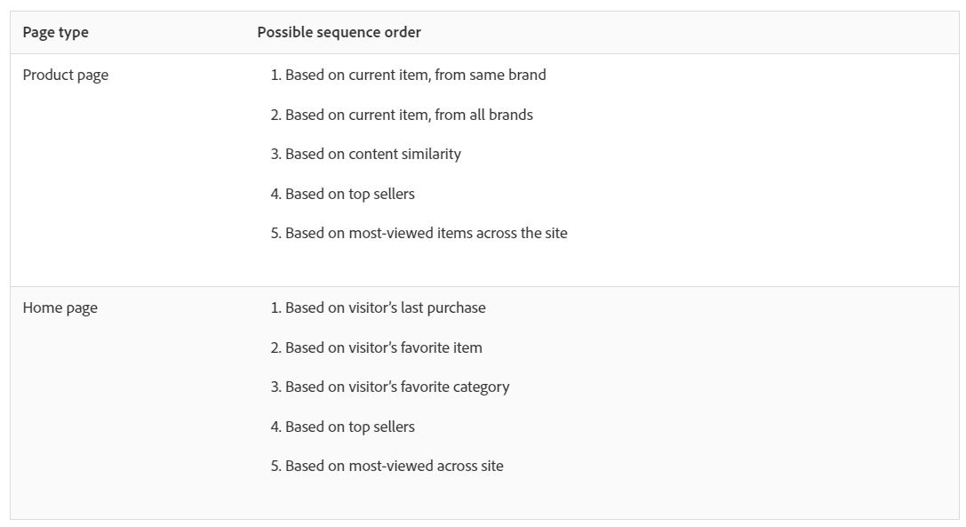
Criteria
Create criteria sequences
Use sequences of up to five criteria to exercise greater control of the items that appear in your Recommendations activities. You can also limit the number of items returned (sometimes referred to as “slot level control.”)

Slide 117
Criteria
Site Affinity
Recommends items based on the certainty of a relationship between items. You can configure this criteria to determine how much data is required before a recommendation is presented using the Inclusion Rules slider. For example, if you select very strong, the products with the strongest certainty of a match are recommended.
For example, if you set a very strong affinity and your design includes five items, three of which meet the strength of connection threshold, the two items that do not meet the minimum strength requirements are not displayed in your recommendations and are replaced by your defined backup items. The items with the strongest affinity display first.

Slide 118
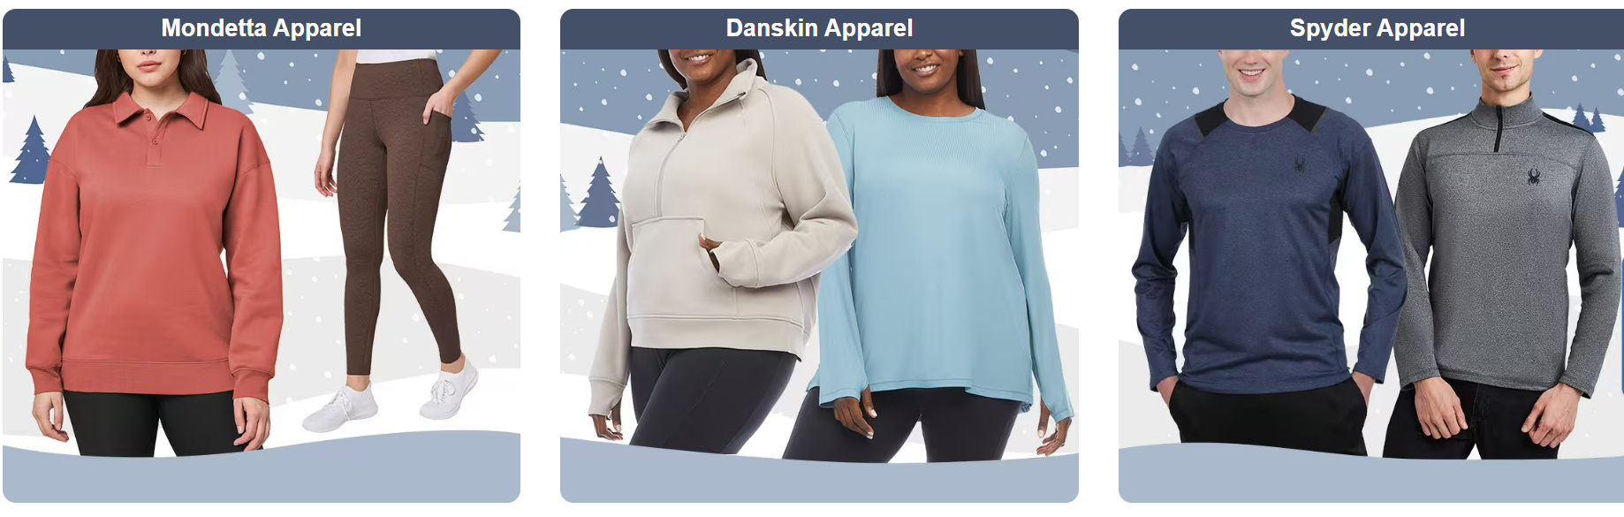
Design
Designs in Adobe Target Recommendations define how recommendations appear on a page. Designs define the layout and format of your recommendations to improve visitor engagement, conversion, and revenue.
Recommendations comes with several default (pre-build) designs or you can create your own.
3*1 Design:

Slide 119
Design
A design defines how recommendations appear on a page.
You can create a Recommendations design using a default design or by creating a custom design. The Recommendations > Designs screen displays both default design cards and any designs that have been created in your account.
Keep the following information in mind as you work with designs:
You can create a recommendations design by using a default design or you can create a custom design.
You cannot edit or delete a default design.
You can edit, copy, or delete a custom design.
To create a design based on a default design, you must first copy the design and then edit the copy.

Slide 120
Design
Sample Design code:
#*
* "Return a simple list of recommended entity ids"
*#
{
"notes":{
"purpose": "Return a simple list of recommended entity ids",
"use-case": "Use this approach if you prefer to do a real-time lookup of entity attribute details (such as inventory, price, rating) from another system (such as a CMS, PIM or ecommerce platform)",
"version": "01"
},
"recommendedItems": {
"key": "$key.id",
"slot-01": "$entity1.id",
"slot-02": "$entity2.id",
"slot-03": "$entity3.id",
"slot-04": "$entity4.id",
"slot-05": "$entity5.id",
"slot-06": "$entity6.id",
"slot-07": "$entity7.id",
"slot-08": "$entity8.id",
"slot-09": "$entity9.id",
"slot-10": "$entity10.id"
}
}

Slide 121
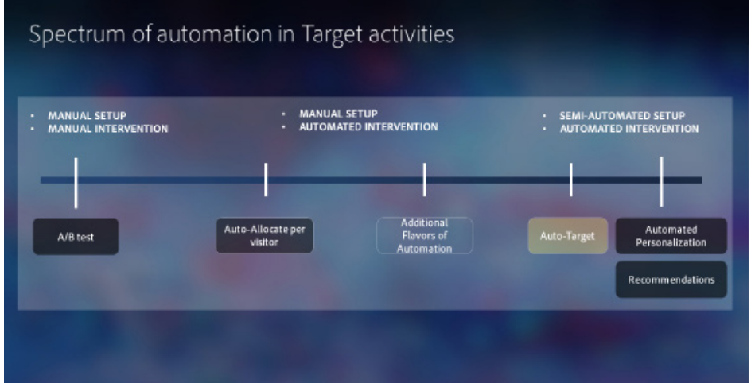
Spectrum of Automation in Target Activities

Slide 122
Activity Collisions
Activity Collisions occur when you design one or more activities so they share the same activity URL. The Collisions tab shows potential collisions, listing the URL and mbox(es) where the collisions may occur. Note that while it lists the audience as reference, it does not actually evaluate audiences to definitively determine if there is a conflict—that task falls to you.
Adobe Target evaluates activity collisions based on the main activity URL specified in the VEC.
When assessing activity collisions, users may:
• Evaluate the Status, Audience, and Priority to determine the likelihood of a collision. • Adjust the Status, Audience, or Priority to prevent collisions.
• Use additional tools to quantify the initial results shown in the Collisions view

Slide 123
Activity Priorities & Conflict Resolution
When the conflicting activities were all created in the VEC
1. Target determines all the activities for which the visitor qualifies.
2. Content for matching activities and experiences is returned.
If the content across all activities references different areas of the page, all content is returned into those different areas.
If any content across the activities references the same area of the page, the highest priority activity content is returned.
If any content across the activities references the same area of the page and multiple activities share the same priority level, the following tie breakers are applied:
If only one activity has audience targeting, that activity is displayed.
ii. If all or none have targeting, then the most-recently activated activity is displayed

Slide 124
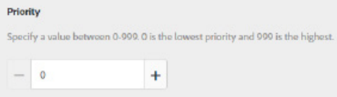

Activity Priorities & Conflict Resolution
Priority may be set at the account level to have 1000 values, as shown here, or it may use three values of Low, Medium, and High
In cases where two activities were created in the VEC, and they share only one location in common, the higher priority activity will win control of that single location. The uncontested location will display from the other activity

Slide 125

Activity Priorities & Conflict Resolution
When the conflicting activities were all created in the FEC.
Here is the method used to evaluate conflicts in this case:
Target attempts to match the visitor into the highest priority activity.
If multiple activities share the same priority level, the following tie breakers are applied:
If only one activity has audience targeting, that activity is displayed.
If all or none have targeting, then the most-recently activated activity is displayed

Slide 126

Activity Priorities & Conflict Resolution
How Are Targeting Percentages Handled Regarding Campaign Priority?

Slide 127
Activity Priorities & Conflict Resolution
Tips and Guidelines
Try to avoid conflicts: have your activities use distinct pages or distinct areas of the page (distinct selectors) and set priority levels intentionally.
Set all activities to low priority. Set an exclusive targeting rule on the new pending activities to ensure only you can view the content. Example: URL Parameter testing=true. Once only you can view the content, make the pending activity high priority for the QA period.
Design your tests to avoid questions of conflict resolution by using activity priority and coordinating across your team.

Slide 128
Content
FAQs
Experience Fragments

Slide 129
Questions
Which experience displays if a user qualifies for an activity that contains multiple experiences with multiple qualifying audiences?
Can I run an activity spanning multiple pages where the page structure is same?
How can I ensure that once a goal (Primary or Secondary) has been reached, a user never enters the activity again and instead sees a different activity going forward?

Slide 130

Experience Fragments

Slide 131

Experience Fragments
Tools>Cloud Services>Adobe Target

Slide 132

Experience Fragments
- Choose your site browser configuration folder and create new Adobe Target configuration

Slide 133


Experience Fragments
IMS Configurations:
- Tools>Security>Adobe IMS Configuration>Create

Slide 134

Experience Fragments
- In another tab, go to Adobe IO and create a new project for Adobe Target APIs.
- Upload Public key for IMS configuration
- Select profile for access and save configuration

Slide 135

Experience Fragments
- Go back to IMS Configurations, click on next and paste client ID as API key and client secret. Give a name to the configuration.
- For JWT payload and authorization server details, go back to IO and go to JWT section

Slide 136

Experience Fragments

Slide 137

Experience Fragments
Perform Health Check to receive access token:

Slide 138

Experience Fragments

Slide 139

Experience Fragments

Slide 140

Experience Fragments

Slide 141

Experience Fragments

Slide 142
Regional Mbox at.js 1.x
adobe.target.getOffer({
"mbox": "target-global-mbox",
"params": {
"a": 1,
"b": 2
},
"success": function(offer) {
adobe.target.applyOffer( {
"mbox": "target-global-mbox",
"offer": offer
} );
},
"error": function(status, error) {
console.log('Error', status, error);
}
});

Slide 143
Regional Mbox- at.js 2.x
<div class="mboxDefault">
default content to replace by offer
</div>
<script>
var el = document.currentScript.previousElementSibling;
adobe.target.getOffer({
mbox: "mboxName",
params: {
param1: "value1",
param2: "value2"
},
success: function(offer) {
adobe.target.applyOffer({
mbox: "mboxName",
selector: el,
offer: offer
});
},
error: function(error) {
console.error(error);
el.style.visibility = "visible";
}
});
</script>

Slide 144

Order Confirmation Mbox
An order confirmation mbox can be deployed client-side on ecommerce sites to track purchase-related details and to enable revenue and order reporting.

Slide 145


A4T
The Analytics for Target integration between Analytics and Target provides powerful analysis and timesaving tools for your optimization program.
The three primary benefits of using Analytics data in Target are:
Marketers can dynamically apply Analytics success metrics or reporting segments to Target activity reports at any time. It is not required to specify everything before running the activity.
A single source of data eliminates the variance that occurs when collecting data in two separate systems.
Your existing Analytics implementation collects all required data. There is no need to implement mboxes on pages for the sole purpose of collecting data for reports.

Slide 146

A4T

Slide 147
Question
Use Case 1: The client wants you to create two A/B test with a 50% discount offer and BOGO offer for all visitors. Anyone who sees 50% discount experience should not see BOGO offer and vice versa.
Use Case 2: You handle personalization for an Indian brand website which targets visitors all across Indian states. You have a redesign for some cities(Kolkata, Delhi, Mumbai, Chennai) and another design for visitors across Karnataka and Delhi. Create a personalization activity for this redesign?
Use Case 3: The client wants you to create a test targeting the hero banner, logo and the banner content for all desktop visitors. You have 4 offers for hero banner, 2 versions of logo and 3 banner headlines. You are confused on the traffic split between the experience versions. How will you create this activity?

Slide 148
Question
Use Case 5: In this scenario, you want to display a hiking image to visitors from USA and a surfing image to visitors from UK. You also have an audience that likes bicycling. You want to display a third hero image that appeals to your biking audience. For other visitors you want to show a football image.
Use Case 6:

Slide 149
Q & A

